Slide 1

Defending Against Model Stealing Attacks with
Adaptive Misinformation
CVPR 2020
Sanjay Kariyappa
Moinuddin Qureshi
Notes:
Hi. I am Sanjay. I will talk about defending against model stealing attacks with Adaptive Misinformation [click]

Slide 2

Model Stealing Attacks: Security Implications
Compromises model confidentiality
Adversarial Attacks
Black-Box
Target Model
Clone Model
Membership inference, Model inversion attacks
Notes:
Model Stealing attacks allow an adversary with black box access to a target model to create a high accuracy clone model. [click] These attacks not only compromise model confidentiality, but can also be used to break security and leak sensitive training data. [click]

Slide 3
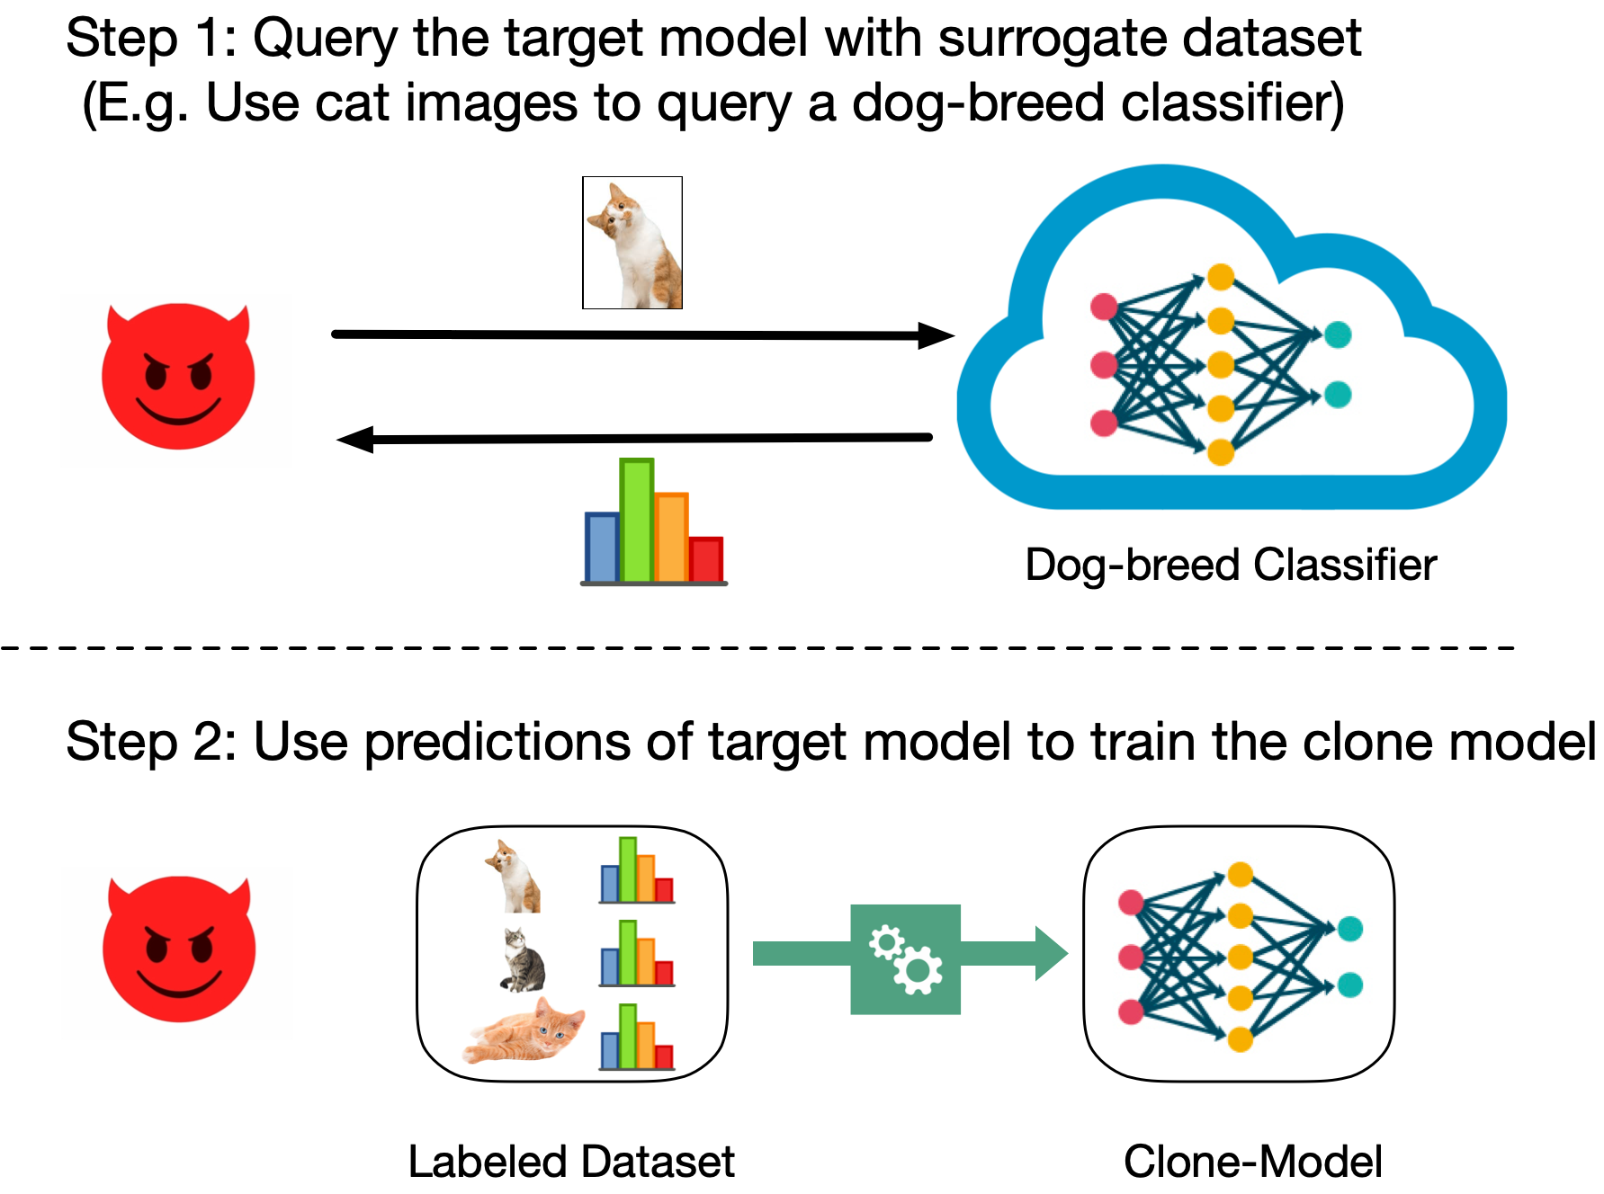
Model Stealing Using Surrogate or Synthetic Datasets
Our Goal: Develop a defense against model stealing attacks in the data-limited setting
Notes:
Recent attacks use synthetic or surrogate data to carry out model stealing when training data is unavailable to the adversary. Our goal is to develop a defense against such attacks. [click]

Slide 4
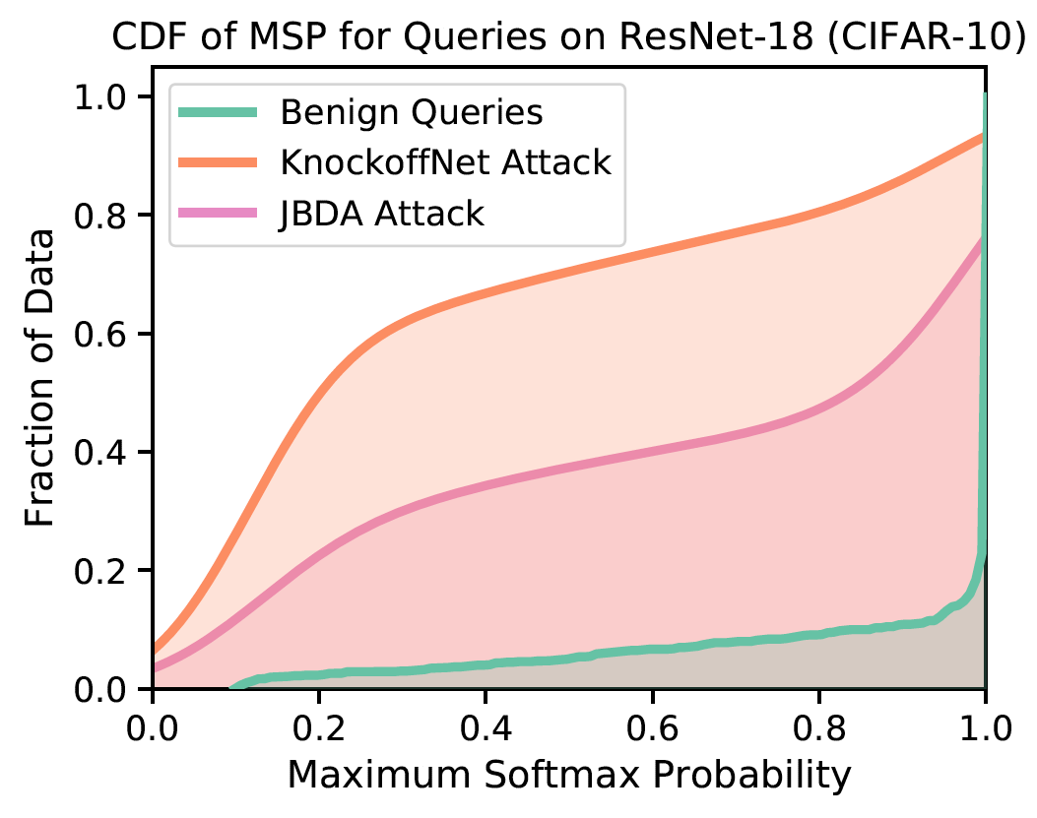
Key Insight: Adversary’s queries are OOD
Adversary’s queries tend to be Out-of-Distribution ➔ Low Maximum Softmax Probability
Notes:
Our key insight is that existing model stealing attacks invariably use out of distribution data to query the target model. Such OOD queries produce low-confidence predictions compared to benign queries. [click]

Slide 5
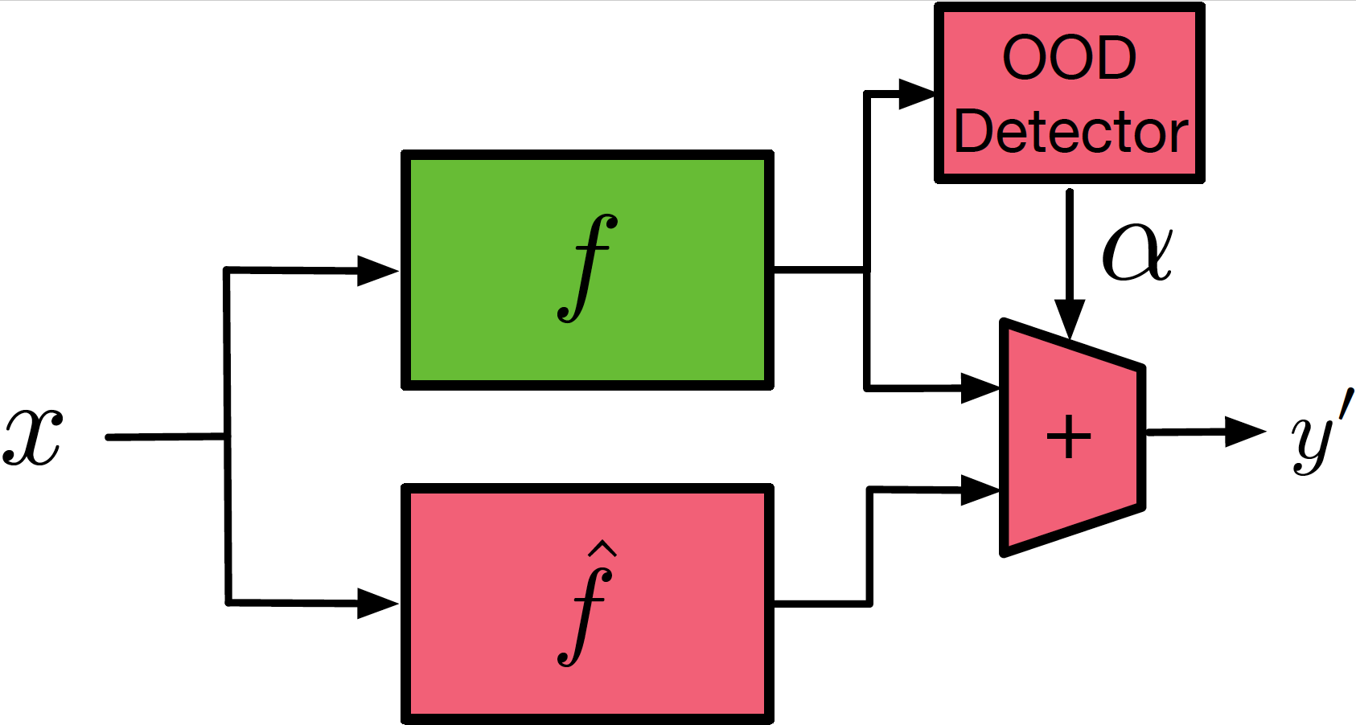

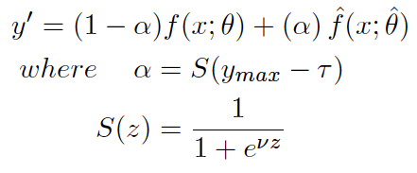
Our Proposal: Adaptive Misinformation
Selectively service the OOD queries with incorrect predictions (misinformation)
Use the OOD detector to combine the outputs of $f$ and $\hat{f}$ depending on the input
ID queries (Benign) are serviced using the original model $f$
OOD queries (Adversarial) are serviced using misinformation model $\hat{f}$
Notes:
Our defense leverages this insight by selectively servicing OOD queries with incorrect predictions to mislead the adversary. This prevents an adversary from learning the true predictions of the model, while servicing queries from benign users correctly. [click]

Slide 6
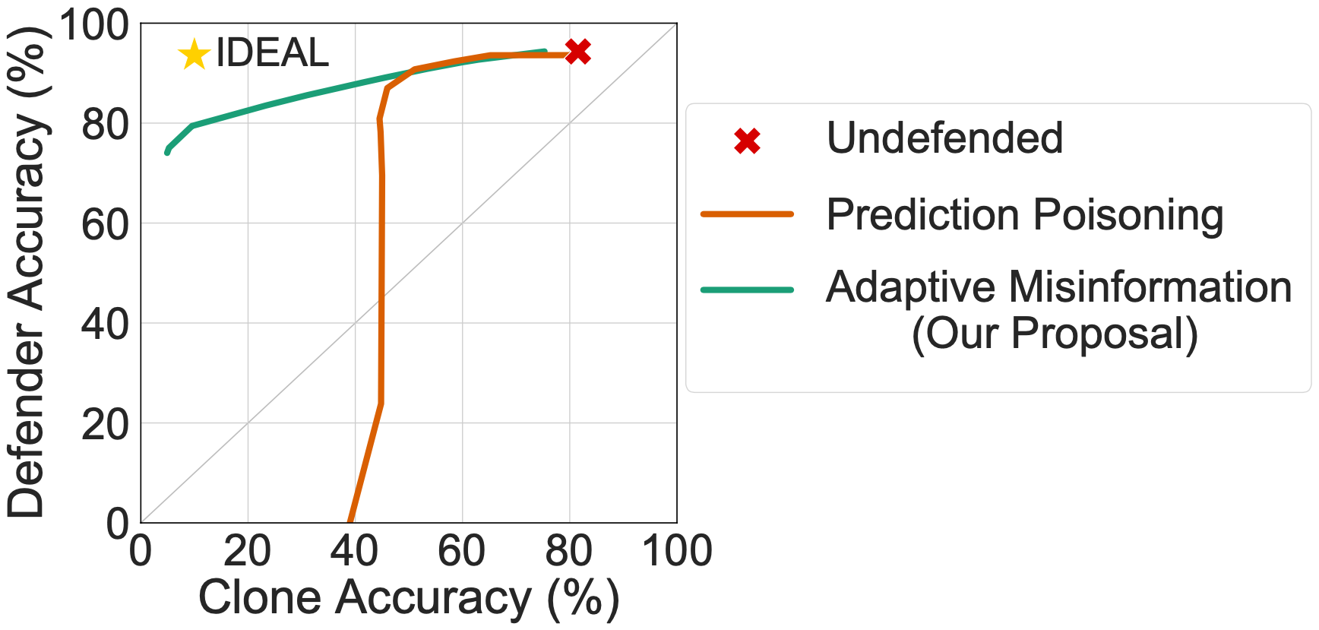
Key Results
KnockoffNets attack on ResNet-18 model trained for CIFAR-10
AM significantly degrades clone acc (up to 40%) with minimal impact on defender acc (<0.5%).
Better security vs accuracy trade-off compared to existing defenses.
Notes:
We evaluate our defense by plotting the trade-off between clone accuracy on the x-axis and defender accuracy on the y-axis. An ideal defense minimizes clone accuracy without degrading defender accuracy.
Our defense offers a significantly better trade-off between security and accuracy compared to prior works.
Thank you for listening and please stop by our panel.
%Our defense reduces clone accuracy by up to 40% with minimal impact on defender accuracy and offers a significantly better trade-off between security and accuracy compared to prior works.

