Slide 1
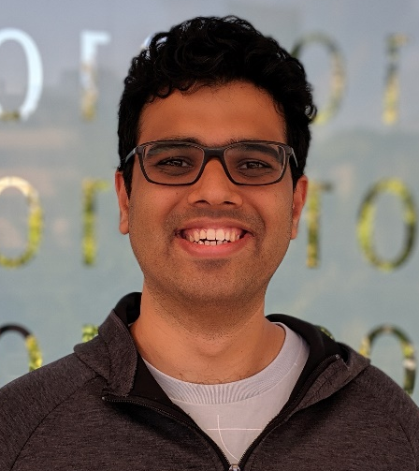

Mitigating Measurement Errors in Quantum Computers by Exploiting State-Dependent Bias
MICRO-52
Swamit Tannu and Moinuddin Qureshi
Notes:
Good afternoon, I am Swamit from Georgia Tech. Today I will talk about how we reduce measurement errors on exisiting quantum computers

Slide 2

Near-term Quantum Computers will be Noisy!
Error
Incorrect
Output
Quantum Computer
Quantum Bits
Can’t enable fault-tolerance using quantum error correction→ Noisy Intermediate Scale Quantum (NISQ) Computers
Notes:
We know that quantum computers are noisy and until we can afford quantum error correction we have to live with noisy qubits.

Slide 3
Execution Model for NISQ
Error
Error
Error free outcome
Execute
Compute
(perform gates)
Measure
(read qubits)
Erroneous outcome
Quantum
Program
Output
Repeat for N Trials
Quantum gates and measurements introduce errors
Notes:
Noisy qubits produce errors and that forces us to run a program for multiple trials. Log out of each trial, by output log for N trials we can infer correct answer.
When executing, a program goes through a compute phase first and then measurement phase. In compute phase we use quantum gates to transform qubit state and in measurement phase we read out the qubits, unfortunately both compute and measurement are prone to errors

Slide 4
Error on IBMQ14 Quantum Computer
Error Rate
Qubit measurement error → dominant error
Notes:
For example, Measurement of qubits is one of the dominant source of errors.
And goal of paper is to reduce impact of measurement errors. Let me share a simple experiment that will help us understand measurement errors and devlop strategies to mitigate measurement errors . (clik)

Slide 5
Experiments on IBM Quantum Computer
Correct Answer
0
1
84%
Measure
Probability
0
0
0
0
0
2
All zero state
16%
3
4
ibmqx4
Probability
1
1
1
1
1
Measure
62%
All one state
38%
Invert
Measure
78%
1
1
1
1
1
Probability
22%
All one state
Measurement errors have directional bias
Notes:
So in this experiment, We initialize IBM 5 qubit machine to all zero state and measured the output, 84% probability that we got the right answer
Now if we take the same ibm machine and intialuize it to all one state and meaure, we get the right answer with only 62% probability
So the all one state is more vulnerable than all zero state
what if we took all one state and inverted it using quantum gates and then measured the output, we get the right answer with 78% probability.
Because on IBM machine State -1 is high energy state and state 0 is low energy state and
State 1 naturally go to low energy state

Slide 6
Insight – Leveraging Measurement Bias
Insight
Exploit the state-dependent bias to reduce the impact of measurement errors
Notes:
We can exploit this state dependent bias to mitigate measurement errors and improve the overall reliability of quantum computer that are available today. And that’s the insight we use in our paper.

Slide 7
OUTLINE
Introduction
Characterization of Measurement Bias
Static Invert and Measure (SIM)
Adaptive Invert and Measure (AIM)
Evaluations

Slide 8
Measurement Bias on IBM Machine (IBMQ-14)
We measure all 10 bit basis states (2¹⁰) on fourteen qubit machine
0000000000
2.5x
Measurement
Strength
1111111111
Hamming Weight of Basis States
Measurement Strength is negatively corelated to Hamming weight of data
Notes:
So measurement bias is not limited to 5 qubit machine, infact on IBM;s 14 qubit machine we observe measurement bias as well. For example, we prepare and measure all 10 bit states classical state. This graph shows a condensed version of the data that we collected. It shows with increasing hamming weight Measurements are more prone to errors, for example, state of all ones is 2.5 times more vulnerable than state of all zeroes

Slide 9
Impact of Bias on Superposition State
GHZ-5 State
0
0
0
0
0
(50%)
Measure
(Ideal Machine)
1
1
1
1
1
(50%)
GHZ-5 State
0
0
0
0
0
(41%)
Measure
(IBMQ-14)
1
1
1
1
1
(12%)
Other Erroneous States ( 47%)
Measurement Bias Effects Quantum States with Superposition
Notes:
So far we discussed classical states where there was no superposition but on quantum machines we care superposition and correct output can often a superposition state.
How does this measurement error affect our answer?

Slide 10

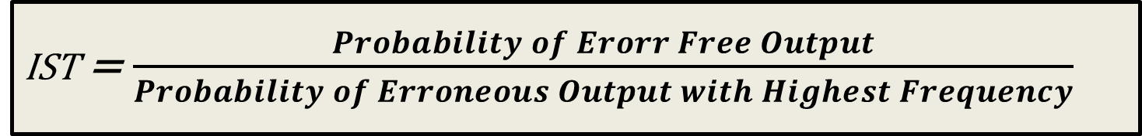


Figure of Merit: Inference Strength (IST)
IST = $\frac{Probability of Erorr Free Output}{Probability of Erroneous Output with Highest Frequency}$
IST = $\frac{0.35}{0.40}$ = 0.87
IST = $\frac{0.3}{0.25}$ = 1.25
PST = 0.35
PST = 0.30
40%
35%
30%
25%
25%
Incorrect
Inference
10%
Correct
Inference
20%
5%
A
B
C
D
A
B
C
D
IST captures quality of inference. IST > 1 ensures correct answer is strongest

Slide 11
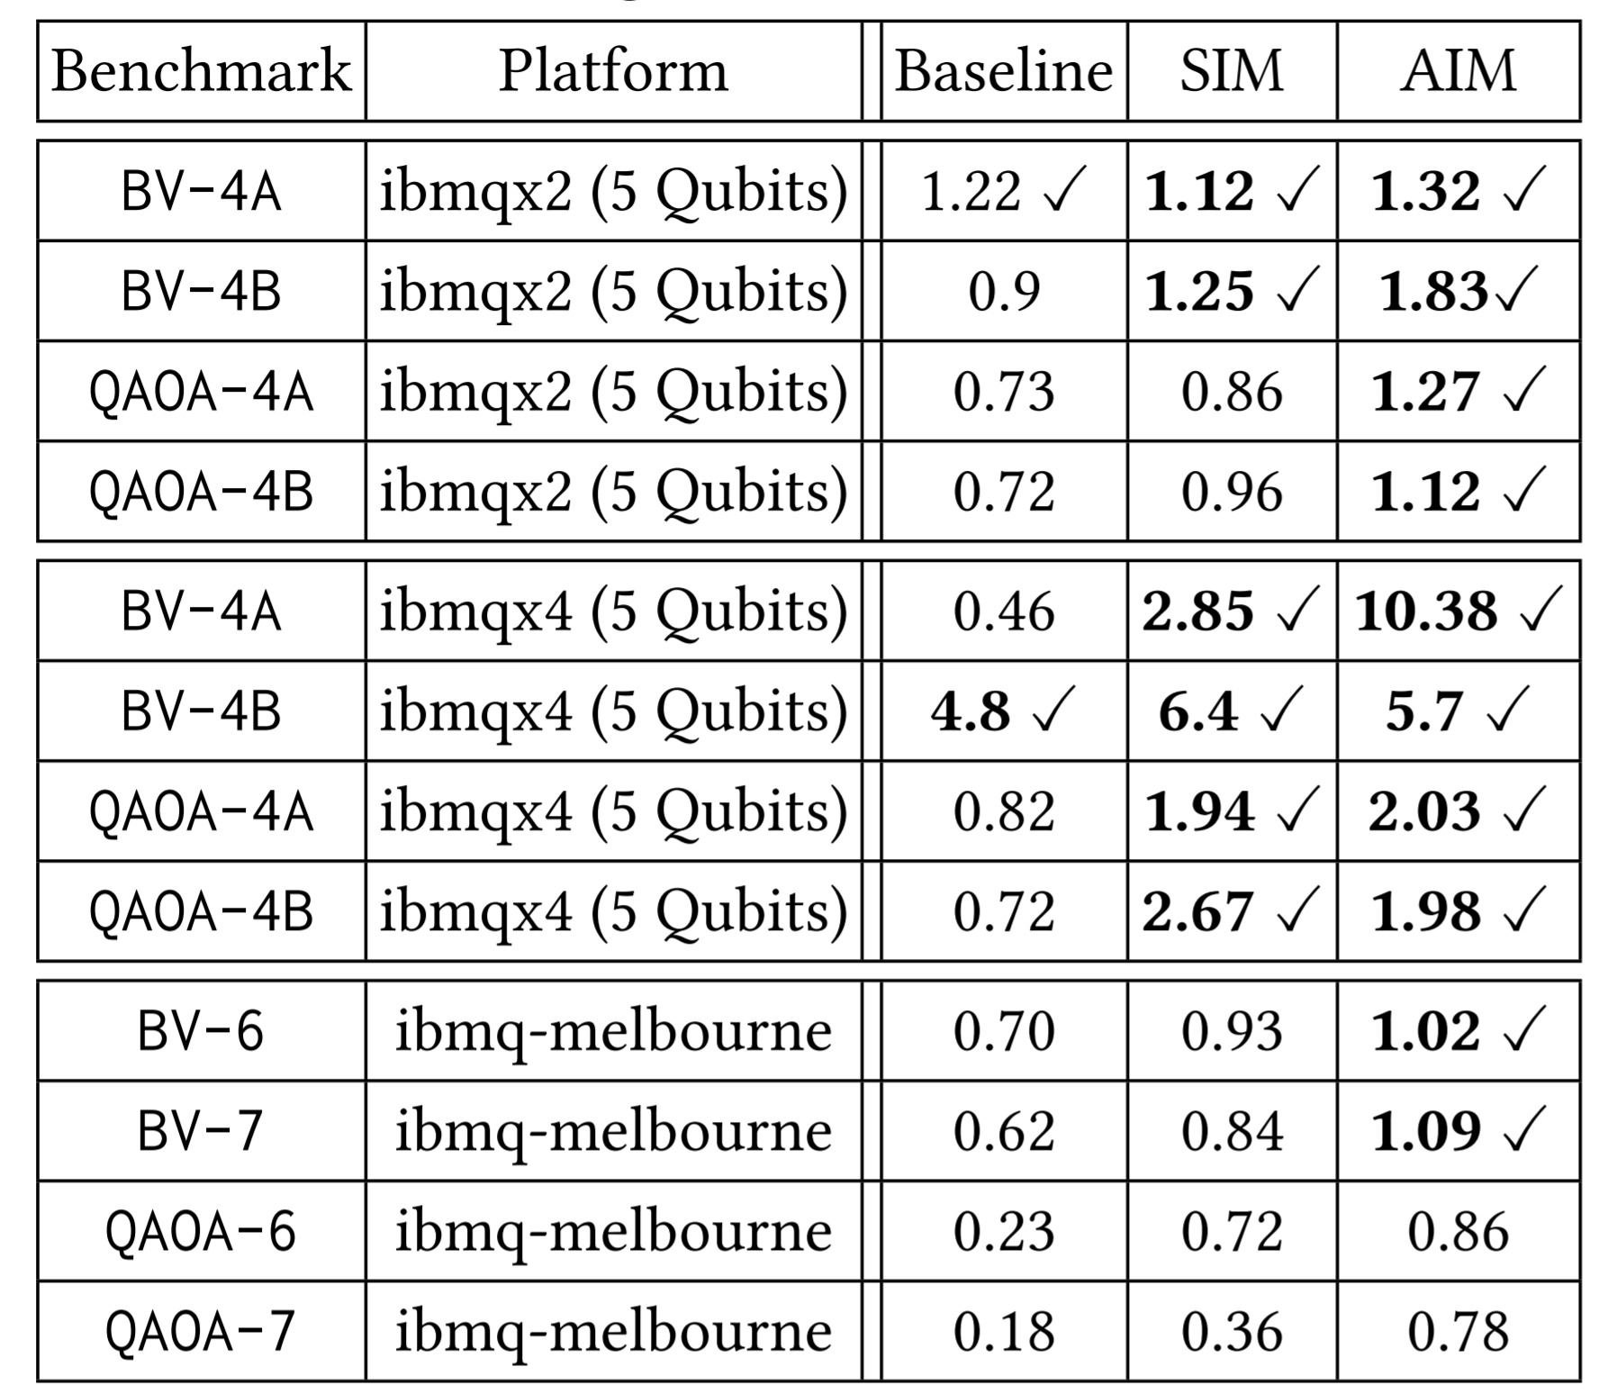

IST of Baseline
IBMQX2
(5 Qubits)
IST captures quality of inference. IST > 1 ensures correct answer is strongest
IBMQX4
(5 Qubits)
IBMQ-Melbourne
(14 Qubits)
Goal: Improve NISQ reliability by exploiting measurement bias
Notes:
We run four benchmarks on 3 IBM quantum machines 2 with 5 qubits and one with 14 qubit, and observe IST to be less than 1 for most of the benchmarks, only 2 of the benchmarks have IST greater than 1.
Goal of our paper is to improve NISQ reliability by exploiting measurement bias,

Slide 12
OUTLINE
Introduction
Bias Characterization
Static Invert and Measure (SIM)
Adaptive Invert and Measure (AIM)
Evaluations

Slide 13
To Invert or Not to Invert?
Correct Answer
Probability
1
1
1
1
1
Measure
62%
38%
Invert
Measure
78%
1
1
1
1
1
Probability
22%
Invert
Measure
58%
0
0
0
0
0
Probability
42%
If done naively, inversion can degrade reliability
Notes:
So we know inverting and measuring a weak state like all ones reduce measurement error … but when we run real applications, we don’t know what the correct answer is. For

Slide 14



Static Invert and Measure (SIM)
$$\frac{N}{2}$$
trials
Measure
$$N$$
trials
Invert
Measure
$$\frac{N}{2}$$
trials
Create two copies of program: one with inverted measurement and other with standard measurement
Notes:
11 MIN

Slide 15
Impact of SIM on Measurement Bias
Baseline with Bias
Invert and Measure
Measurement
Strength
Hamming Weight of Basis States
For monotonically decreasing measurement fidelity with Hamming weight,
Invert and Measure reduces gap between worst case and average error rate
Notes:
Its almost average →

Slide 16




Generalization of Static Invert and Measure
Measure
$$\frac{N}{4}$$
0
0
0
0
0
trials
0
0
0
0
0
$$\frac{N}{4}$$
Invert
Measure
trials
1
1
1
1
1
Partial
Invert
$$\frac{N}{4}$$
Measure
trials
1
0
1
0
1
Partial
Invert
$$\frac{N}{4}$$
0
1
0
1
0
Measure
trials
Using partial inversions, transform any input state to any other state
Notes:
Inversion String

Slide 17
IST of Baseline and SIM
IBMQX2
(5 Qubits)
IST captures quality of inference. IST > 1 ensures correct answer is strongest
IBMQX4
(5 Qubits)
IBMQ-Melbourne
(14 Qubits)
SIM operates at average-case. Can we do better?
Notes:
In the last talk we discussed
Probability of
We propose
8 MIN

Slide 18
OUTLINE
Introduction
Bias Characterization
Static Invert and Measure (SIM)
Adaptive Invert and Measure (AIM)
Evaluations

Slide 19
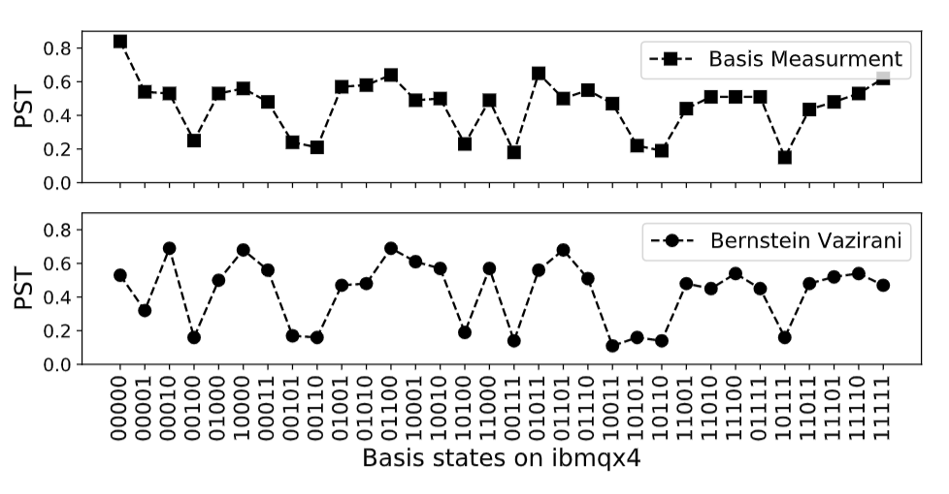
Presence of Arbitrary Measurement Bias
We measure all basis states on IBM’s five qubit machine – ibmqx4
For five qubit machine we have 2⁵ (32) basis states (00000 to 11111)
Measurement
Strength
Basis States in Ascending order of Hamming Weight
11111
00000
11111
00000
Measurement Bias may not be predictable
Notes:
Experiment setup

Slide 20
Adaptive Invert and Measure (AIM): Design
Bias
Estimator
Measurement
Strength
NISQ machine
Adaptive Algorithm
Efficient
Partial
Inversions
Application Test Runs
Boost
Weak-state
Most Likely
Output
NISQ machine
Measurement bias can be learned, and we use it to find inversions that will ensure strong to weak transformation
Notes:
Explain with Highlevel

Slide 21
Evaluations: Improvement in Inference Strength
IBMQX4
(5 Qubits)
Inference Strength
(IST) captures quality of inference. IST > 1 ensures correct answer is most likely
IBMQX4
(5 Qubits)
IBMQ-Melbourne
(14 Qubits)
Notes:
16 MIN
PST →
Convert to line graph

Slide 22
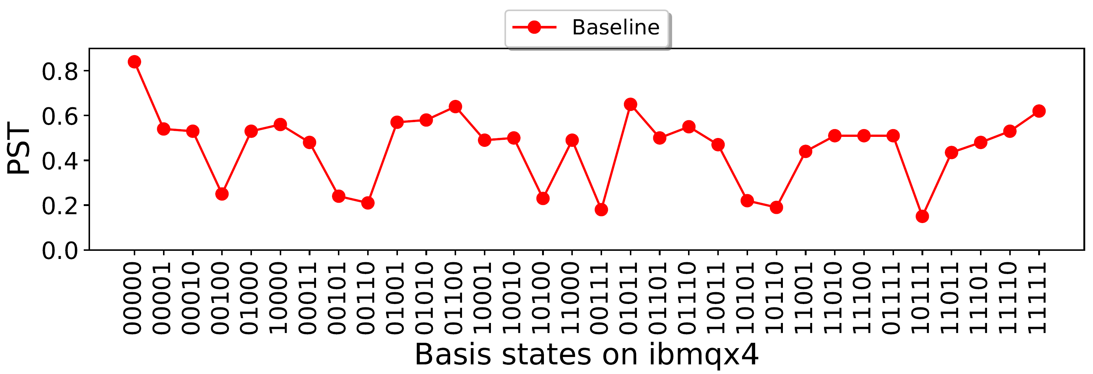
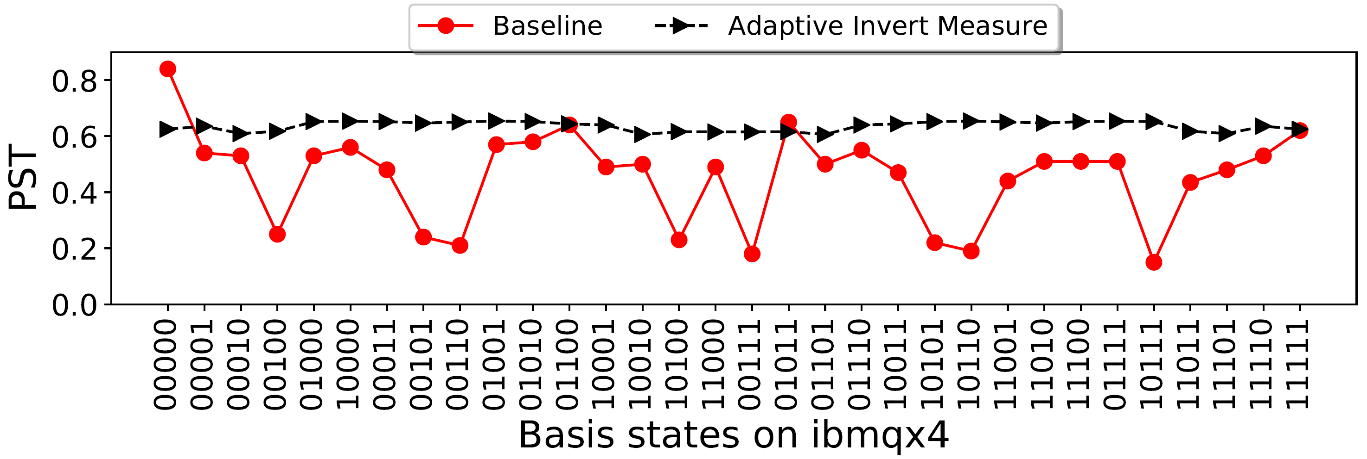
Impact of Bias on Bernstein Vazirani (BV) Algorithm
Run BV Algorithm
Adaptive Invert and Measure mitigate the measurement bias such that all basis states have better than average measurement fidelity
Notes:
Add figure to explain BV quickly

Slide 23
OUTLINE
Introduction
Bias Characterization
Static Invert and Measure (SIM)
Adaptive Invert and Measure (AIM)
Evaluations
Conclusion

Slide 24
Summary
Measurement is a dominant source of errors on NISQ
Measurement errors have state dependent bias
We mitigate the measurement bias using Static Invert and Measure (SIM) and Adaptive Invert and Measure (AIM)
SIM and AIM improves the reliability by up to 2x and 3x on IBMQ and significantly improve the ability to do correct inference.
Notes:
Improvement in PST and IST

Slide 25
Thank you

Slide 26
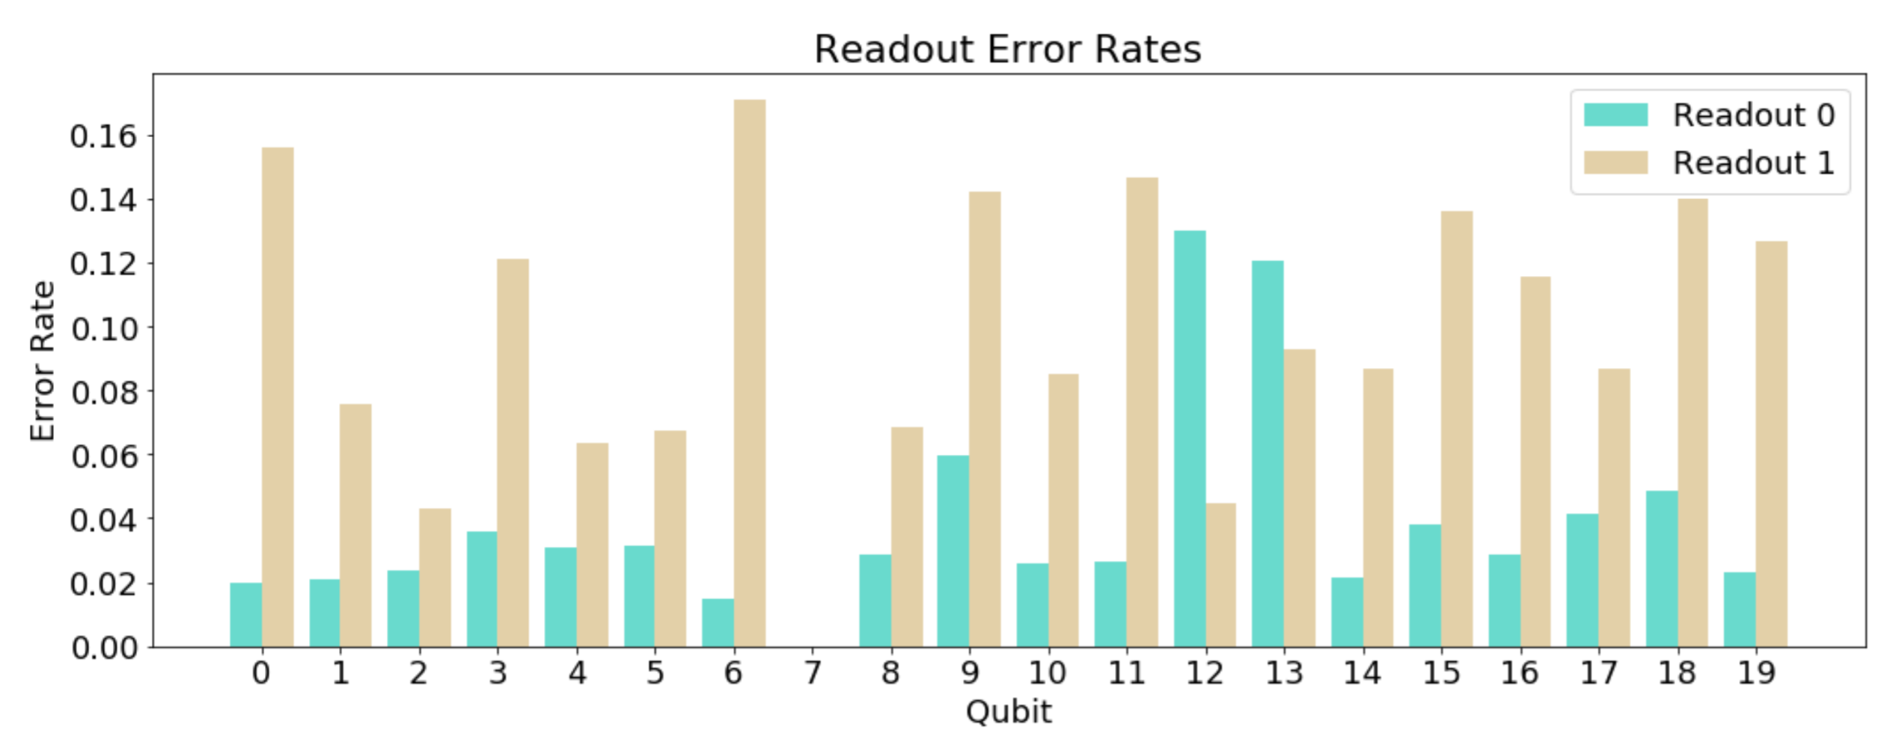
IBM 20 Qubit Machine → Measurement Bias
Source: “Experimentally Characterizing IBM Quantum Processors” Megan Lily and Travis Humble (Oak Ridge) , at QRE2019

Slide 27
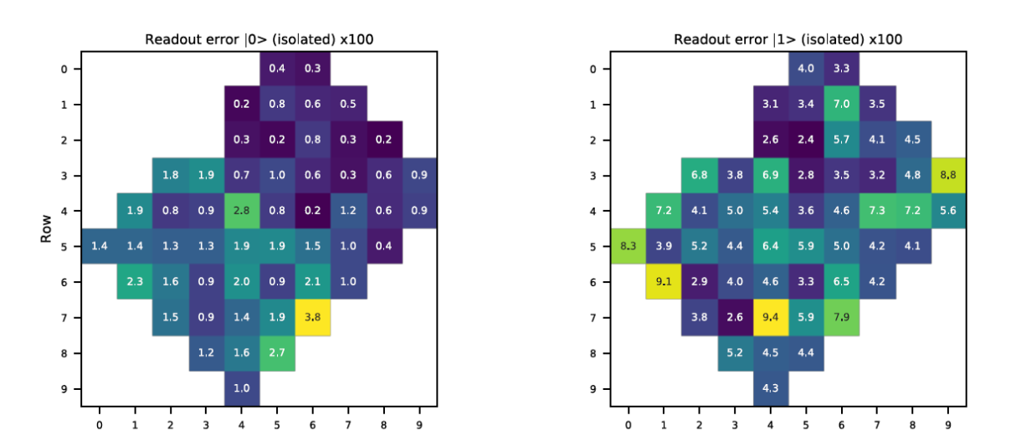
Google’s 53 Qubit Machine → Measurement Bias
Measurement Error for reading State “0”
Measurement Error for reading State “1”
Source: “Quantum supremacy using a programmable superconducting processor”
Notes:
0.4, 0.3,0.5, 0.2,0.8,0.6

Slide 28
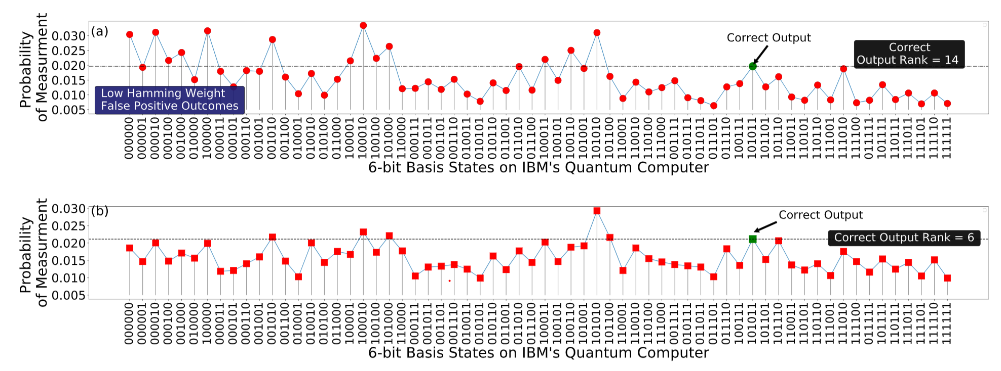
Invert and Measure on IBMQ
Baseline
Invert and Measure

Slide 29
Impact of Bias on Bernstein Vazirani (BV) Algorithm
Run BV algorithm with all five bit keys on “ibmqx4” machine
00100
(key)
Initialize
Qubits
00000
(key)
Measure
Qubits
Output = 00100
(Probability of Success = 0.18)
Output = 00000
(Probability of Success = 0.58)
Run BV Algorithm
Basis States in Ascending order of Hamming Weight
00000
00000
00100
11111
Bias can make some answers more vulnerable than others
Notes:
Add figure to explain BV quickly

